Slide 1
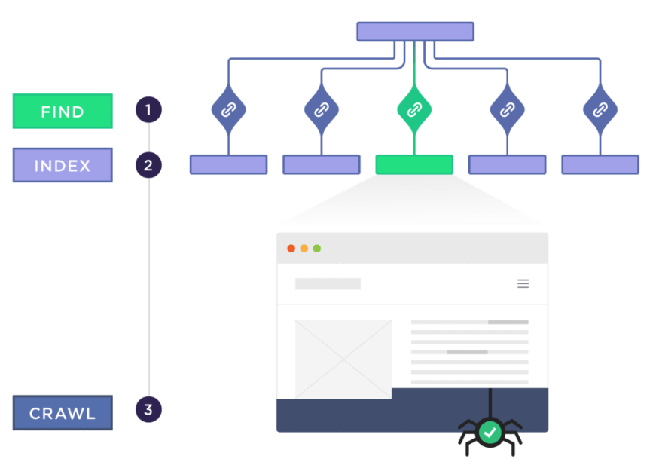
off-page seo
Sahar andaleeb
Week # 05-06
Off-page SEO
By: Sahar Andaleeb

Slide 2
What is off Page SEO?
“Off-page SEO refers to optimization efforts made outside of your own website to improve its search engine rankings.”
This includes activities like building backlinks, increasing brand mentions, and increasing engagement and shares on social media.
Off0-page SEO establishes your website's authority and credibility across the web
Off-Page SEO a.k.a Off-Site SEO
Off-page SEO requires careful planning and execution

Slide 3
Importance of off page seo
Is off-page SEO important?
It helps improve your website's visibility and search engine rankings.
It builds trust and authority for your website.
It increases referral traffic from other websites.
It contributes to a well-rounded SEO strategy !?!!
On-page + Technical + Off-page
Always use white-hat link-building techniques for off-page optimization.
One of the most important aspects of creating a better content experience is answering your audience’s questions.

Slide 4
Off-Page SEO Ranking Factors?
Except Google, no one really knows but different experiments shows that below mentioned four factors are of great importance.
Backlinks
Brand Mentions
Customer Reviews
Social Media Marketing
Notes:
Content lifespan refers to the duration of time during which a piece of content remains relevant, useful, and continues to attract engagement or traffic before it becomes outdated or obsolete.

Slide 5
a. backlinks
Quality is more important than quantity.
The more authoritative the website is, the greater the SEO boost from a backlink
Search engines also look at factors such as the:
Relevance of the linking website
Anchor text used in the link
and the overall authority of the linking domain.

Slide 6
Link building
The first step in link building is to create high-quality content that other websites will want to link to.
This can include blog posts, info graphics, videos, and other types of content that are informative and engaging.

Slide 7
backLink building strategy
Guest blogging
Broken link building
Linkable resources
Network
Podcast appearances

Slide 8
Do-follow & no-follow backLink
“Do-follow Backlinks: are links that pass authority (or "link juice") from one website to another”.
Search engines like Google use these links to help determine the ranking of the linked page.
Example:
You run a website about healthy eating and write an article about the benefits of a balanced diet. You link to a well-known nutritionist's website (do-follow)
The do-follow link will helps the nutritionist's website gain authority and improve its search engine ranking.

Slide 9
Do-follow & no-follow backLink…cont.
“No-follow Backlinks: do not pass authority to the linked website.”
They are used to indicate that the link should not influence the ranking of the linked page.
Example:
If you include a link to a sponsored post or a user-generated comment on your blog, you might use a no-follow link to indicate that you don't necessarily endorse the content.
No-follow link does not affect the ranking of the forum comment

Slide 10
1. Guest blogging
“Guest blogging involves writing and publishing content on someone else's website or blog. “
Exposure: Guest blogging exposes your content to a new audience, potentially increasing your brand visibility.
Authority: By contributing valuable content to authoritative sites, you establish yourself as an authority in your field.
Backlinks: Most guest blogging opportunities allow you to include a brief author bio with a link back to your website, generating backlinks.
Traffic: Backlinks from guest posts can drive referral traffic to your site, increasing your website's visibility and potential conversions.
Relationships: Guest blogging helps build relationships with other bloggers and site owners, potentially leading to future collaboration opportunities

Slide 11
2. Broken link building
Broken link building involves finding broken links on other websites and reaching out to the site owners to suggest replacing them with links to relevant content on your own site.
This strategy can help generate backlinks because it provides value to website owners by helping them fix broken links while also offering them high-quality replacement content.

Slide 12
3. Linkable resources
Create high quality content for passive link building in which you create resources that people link to on their own.
To produce high-quality content you can include:
statistics: provide statistics with links to original sources in their articles.
People scour the web trying to find stats that are relevant and recent
case studies: create original case studies by gathering all the relevant data including numbers, email screenshots, analytics screenshots, etc.
Compelling, people can relate too, solution to their problems
Success stories (genuine)

Slide 13
4. Network
Its very important to grow and nurture your network.
Email people to let them know that you appreciate their work.
Connect with them on LinkedIn.
Attend meetups and conferences.

Slide 14
5. Podcast appearances
Podcast appearances can indeed be a valuable strategy for building backlinks.
podcasts should have a significant online presence and a good following.

Slide 15
b. Brand mentions ?
“Brand mention refers to instances where your brand name or website URL is mentioned on other websites, regardless of whether they include a hyperlink.”
These mentions signal to search engines the prominence and authority of your brand, which can positively impact your search engine rankings.
People only cite, reference, and share content they like

Slide 16
… cont.
Examples:
Social media posts and shares mentioning your brand name.
Reviews or testimonials about your products or services on third-party websites.
Blog posts or articles that discuss your brand or mention your products.
Press releases mentioning your company name or activities.
Mentions in forums or discussion boards related to your industry.

Slide 17
c. Customer Reviews
Customer reviews can play a significant role as an off-page SEO ranking factor.
Positive customer reviews build trust and credibility by showcasing others' positive experiences with your products or services. This trust factor influences potential customers and improves your brand's reputation, benefiting your SEO by signaling trustworthiness to search engines.
“Customer reviews are one of the few things that readers are likely to trust, as they have to be earned.”
Richard Jaggs, Director, Resolution Design

Slide 18


d. Social Media Marketing
Maintaining an active presence on social media platforms can increase your brand's visibility and exposure to a broader audience.
While social media marketing may not directly influence traditional SEO ranking factors like backlinks and on-page optimization, its indirect effects on brand visibility, engagement, and authority can contribute to an enhanced off-page SEO profile over time.
Employ services of Social Media to Market your Business.

Slide 19
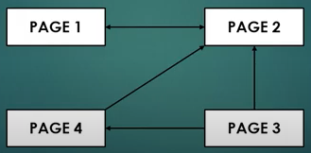
Page rank algorithm
Named after Larry Page, Google co-founder.
PageRank is an algorithm used by Google Search to rank web pages in their search engine results.
“PageRank works by counting number and quality of outbound links to a page to estimate how important that page is. Underlying assumption is that Important websites are likely to receive more links from other websites”.

Slide 20
Working of page rank algorithm
PageRank gives each webpage a score based on how many other webpages link to it and how important those linking pages are. This helps Google figure out which pages are most relevant when you search for something.
Determines importance based on links: more and better quality links = higher importance.
Treats links as votes: a page linking to another is a vote for its quality.
Importance of pages varies: considers both the number and quality of votes.
Pages with higher PageRank rank higher in search results.

Slide 21
TLD & Effect on off page seo
TLD: (Top Level Domain) is the last segment of a domain name, following the final dot.
It helps in categorizing websites
gTLD (generic Top Level Domain) | ccTLD (Country Code Top Level domain)
Not tied to specific country | Reserved for country
Global reach → suitable for targeting international audience | More specific → geographic relevance
Recognized & trusted → enhanced CTR | Helps in giving visibility in local searches
.com .org .net .biz | .pk .uk .ca .ae

Slide 22
Tld…cont.
Choosing between gTLD and ccTLD depends on your business goals, targeted audience, & geographical focus
TLDs are generally not considered a direct part of off-page SEO. However, they can influence off-page SEO indirectly through several factors:
how users and other websites perceive and interact with your domain.
A good choice of TLD can enhance your overall SEO strategy by fostering trust and increasing link opportunities.

Slide 23
Local seo
“Local SEO focuses on optimizing a business's online presence to attract local customers.”
Local SEO impacts off-page SEO by influencing factors like local citations, reviews, and backlinks from local sources.
Local SEO is a Must Have form of Off Page SEO for business with Physical location and service area.
Strategy is to employ Google My Business.
Get your Business on the Map.
Provide relevant and accurate information
Location
Working Hours
Services

Slide 24
E-A-T
E-A-T: Expertise, Authoritativeness, Trustworthiness
Google’s algorithms evaluate E-A-T
Expertise
Concept: Demonstrates the creator's knowledge or skill in the relevant field.
Example: A medical article written by a certified doctor shows expertise.
Authoritativeness
Concept: Reflects the overall authority of the website or content creator.
Example: A blog post about technology trends published by a well-known tech magazine illustrates authoritativeness.
Trustworthiness
Concept: Ensures the website and content creator are reliable and credible.
Example: A website with clear privacy policies and secure connections (HTTPS) represents trustworthiness.

Slide 25
E-A-T…cont.
By focusing on E-A-T, you can improve both on-page and off-page SEO, ultimately boosting your website’s performance in search engine rankings.
Example:
On-Page: A health website has articles written by certified doctors, with clear author bios and secure connections.
Off-Page: The same health website is frequently cited by other reputable health blogs and news sites, enhancing its authority and trustworthiness.

Slide 26
On-page SEO vs Off-page SEO
Class Activity:
Study On-Page SEO vs. Off-Page SEO.. …differences, their impact on your website, their impotance.

